Slide 1
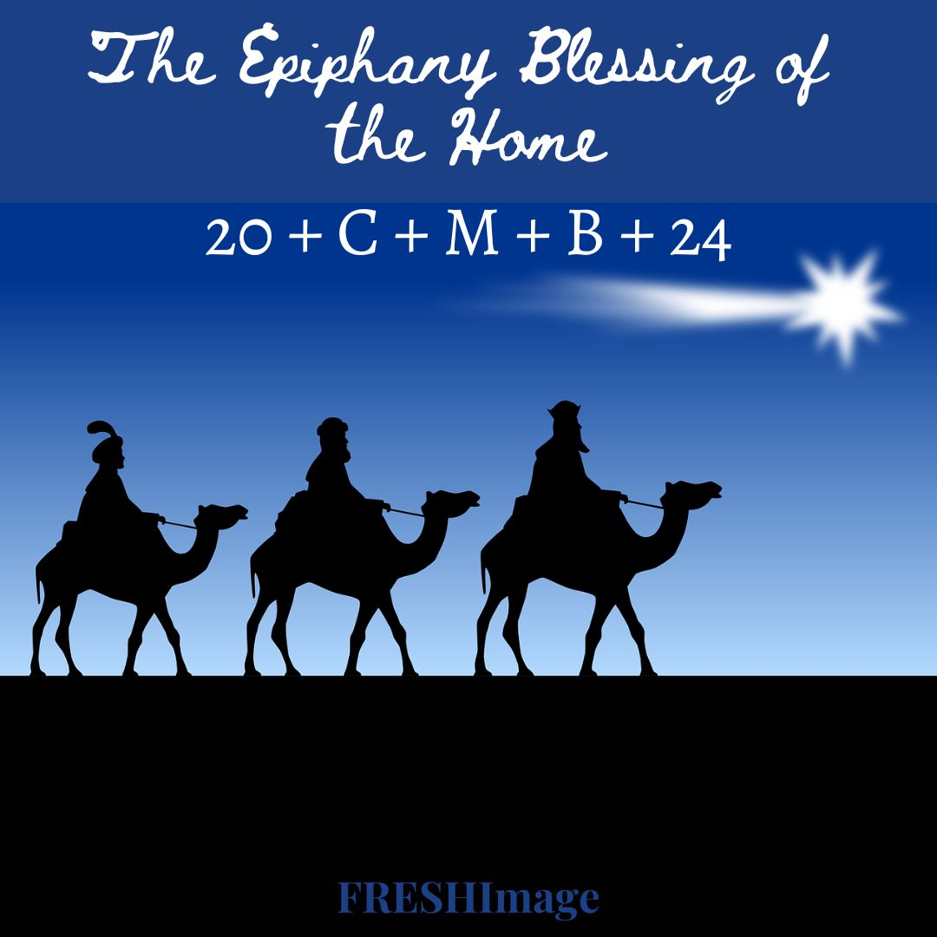

Slide 2
Opening
Let us praise God, who fills our hearts and homes with peace. Blessed be God forever.
R/. Blessed be God forever.

Slide 3
O Come All Ye Faithful
Oh, come, all ye faithful,
Joyful and triumphant!
Oh, come ye, oh come ye to Bethlehem.
Come and behold him,
Born the King of angels;
Oh, come, let us adore him;
Oh, come, let us adore him;
Oh, come, let us adore him,
Christ, the Lord.

Slide 4
O Come All Ye Faithful
Sing, choirs of angels,
Sing in exultation;
— Sing, all ye citizens of heav’n above!
Glory to God,
Glory in the highest;
Oh, come, let us adore him;
Oh, come, let us adore him;
Oh, come, let us adore him,
Christ, the Lord.

Slide 5
Introductory Prayer
The Word became flesh and made his dwelling place among us. It is Christ who enlightens our hearts and homes with his love. May all who enter this home find Christ’s light and love.

Slide 6
Listen to the words of the holy Gospel according to Luke (19:1-9):
Jesus came to Jericho and intended to pass through the town. Now a man there named Zacchaeus, who was a chief tax collector and also a wealthy man, was seeking to see who Jesus was; but he could not see him because of the crowd, for he was short in stature. So he ran ahead and climbed a sycamore tree in order to see Jesus, who was about to pass that way. When he reached the place, Jesus looked up and said to him, “Zacchaeus, come down quickly, for today I must stay at your house.” And he came down quickly and received him with joy.

Slide 7
When they all saw this, they began to grumble, saying, “He has gone to stay at the house of a sinner.” But Zacchaeus stood there and said to the Lord, “Behold, half of my possessions, Lord, I shall give to the poor, and if I have extorted anything from anyone I shall repay it four times over.” And Jesus said to him, “Today salvation has come to this house because this man too is a descendant of Abraham.”
Reader: The Gospel of the Lord.
R/. Praise to you, Lord Jesus Christ.

Slide 8
Intercessions
Leader: The Son of God made his home among us. With thanks and praise let us call upon him.
R/. Stay with us, Lord.
Lord Jesus Christ, with Mary and Joseph you formed the Holy Family: remain in our home that we may know you as our guest and honor your as our Head. We pray:
R/. Stay with us, Lord.

Slide 9
Lord Jesus Christ, you had no place to lay your head, but in the spirit of poverty accepted the hospitality of your friends: grant that through our help the homeless may obtain proper housing. We pray:
R/. Stay with us, Lord.
Lord Jesus Christ, the three kings presented their gifts to you in praise and adoration: grant that those living in this house may use their talents and abilities to your greater glory. We pray:
R/. Stay with us, Lord.

Slide 10
The Lord’s Prayer
Let us pray together in the words our Savior gave us.
Together: Our Father…

Slide 11
Prayer of Blessing
Lord God of heaven and earth, you revealed your only-begotten Son to every nation by the guidance of a star. Bless this house and all who inhabit it. Fill them (us) with the light of Christ, that their (our) concern for others may reflect your love.
We ask this through Christ our Lord.
R/. Amen.

Slide 12
Inscription of the Home
With your blessed chalk, inscribe the wall above the door to your home or a chalkboard plaque with the following:
20 + C + M + B + 24

Slide 13
Closing Prayer
May Christ Jesus dwell with us, keep us from all harm, and make us one in mind and heart, now and forever.
R/. Amen.

Slide 14
We Three Kings
We three kings of Orient are; bearing gifts we traverse afar, field and fountain, moor and mountain, following yonder star.
O star of wonder, star of light,
Star with royal beauty bright,
Westward leading, still proceeding,
Guide us to thy perfect light.

Slide 15
Born a King on Bethlehem's plain, gold I bring to crown him again, King forever, ceasing never, over us all to reign.
O star of wonder, star of light,
Star with royal beauty bright,
Westward leading, still proceeding,
Guide us to thy perfect light.

Slide 16
Frankincense to offer have I; incense owns a Deity nigh; prayer and praising, voices raising, worshipping God on high.
O star of wonder, star of light,
Star with royal beauty bright,
Westward leading, still proceeding,
Guide us to thy perfect light.

Slide 17
Myrrh is mine; its bitter perfume breathes a life of gathering gloom; sorrowing, sighing, bleeding, dying, sealed in the stone-cold tomb.
O star of wonder, star of light,
Star with royal beauty bright,
Westward leading, still proceeding,
Guide us to thy perfect light.

Slide 18
Glorious now behold him arise; King and God and sacrifice: Alleluia, Alleluia, sounds through the earth and skies.
O star of wonder, star of light,
Star with royal beauty bright,
Westward leading, still proceeding,
Guide us to thy perfect light.

