Slide 1
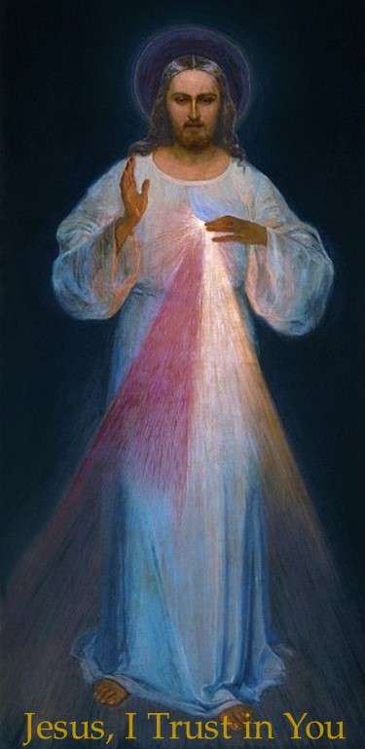
The Chaplet of Divine Mercy

Slide 2
Opening Prayers
The Sign of the Cross
The Intentions of the Holy Father

Slide 3
Opening Prayers Continued
O Jesus, eternal Truth, our Life, I call upon You and I beg Your mercy for poor sinners. O sweetest Heart of my Lord, full of pity and unfathomable mercy, I plead with You for poor sinners. O Most Sacred Heart, Fount of Mercy from which gush forth rays of inconceivable graces upon the entire human race, I beg of You light for poor sinners. O Jesus, be mindful of Your own bitter Passion and do not permit the loss of souls redeemed at so dear a price of Your most precious Blood. O Jesus, when I consider the great price of Your Blood, I rejoice at its immensity, for one drop alone would have been enough for the salvation of all sinners. Although sin is an abyss of wickedness and ingratitude, the price paid for us can never be equaled. Therefore, let every soul trust in the Passion of the Lord, and place its hope in His mercy. God will not deny His mercy to anyone. Heaven and earth may change, but God's mercy will never be exhausted. Oh, what immense joy burns in my heart when I contemplate Your incomprehensible goodness, O Jesus! I desire to bring all sinners to Your feet that they may glorify Your mercy throughout endless ages (Diary of Saint Maria Faustina Kowalska, 72).

Slide 4
Opening Prayers Continued
You expired, Jesus, but the source of life gushed forth for souls, and the ocean of mercy opened up for the whole world. O Fount of Life, unfathomable Divine Mercy, envelop the whole world and empty Yourself out upon us. O Blood and Water, which gushed forth from the Heart of Jesus as a fount of mercy for us, I trust in You!
(Repeat three times)

Slide 5
Opening Prayers Continued
Our Father
Hail Mary
The Apostles’ Creed

Slide 6
1st Decade
Leader: Eternal Father, I offer you the Body and Blood, Soul and Divinity of Your Dearly Beloved Son, Our Lord, Jesus Christ, in atonement for our sins and those of the whole world.
Leader: For the sake of His sorrowful Passion,
R/. Have mercy on us and on the whole world.
(Repeat 10 times)

Slide 7
2nd Decade
Leader: Eternal Father, I offer you the Body and Blood, Soul and Divinity of Your Dearly Beloved Son, Our Lord, Jesus Christ, in atonement for our sins and those of the whole world.
Leader: For the sake of His sorrowful Passion,
R/. Have mercy on us and on the whole world.
(Repeat 10 times)

Slide 8
3rd Decade
Leader: Eternal Father, I offer you the Body and Blood, Soul and Divinity of Your Dearly Beloved Son, Our Lord, Jesus Christ, in atonement for our sins and those of the whole world.
Leader: For the sake of His sorrowful Passion,
R/. Have mercy on us and on the whole world.
(Repeat 10 times)

Slide 9
4th Decade
Leader: Eternal Father, I offer you the Body and Blood, Soul and Divinity of Your Dearly Beloved Son, Our Lord, Jesus Christ, in atonement for our sins and those of the whole world.
Leader: For the sake of His sorrowful Passion,
R/. Have mercy on us and on the whole world.
(Repeat 10 times)

Slide 10
5th Decade
Leader: Eternal Father, I offer you the Body and Blood, Soul and Divinity of Your Dearly Beloved Son, Our Lord, Jesus Christ, in atonement for our sins and those of the whole world.
Leader: For the sake of His sorrowful Passion,
R/. Have mercy on us and on the whole world.
(Repeat 10 times)

Slide 11
Holy God
Together:
Holy God, Holy Mighty One, Holy Immortal One, have mercy on us and on the whole world.
(Repeat 3 times)

Slide 12
Closing Prayers
O Greatly Merciful God, Infinite Goodness, today all mankind calls out from the abyss of its misery to Your mercy — to Your compassion, O God; and it is with its mighty voice of misery that it cries out. Gracious God, do not reject the prayer of this earth's exiles! O Lord, Goodness beyond our understanding, Who are acquainted with our misery through and through, and know that by our own power we cannot ascend to You, we implore You: anticipate us with Your grace and keep on increasing Your mercy in us, that we may faithfully do Your holy will all through our life and at death's hour. Let the omnipotence of Your mercy shield us from the darts of our salvation’s enemies, that we may with confidence, as Your children, await Your [Son’s] final coming — that day known to You alone. And we expect to obtain everything promised us by Jesus in spite of all our wretchedness. For Jesus is our Hope: through His merciful Heart, as through an open gate, we pass through to heaven (Diary of Saint Maria Faustina Kowalska, 1570).

Slide 13
Closing Prayers Continued
Eternal God, in whom mercy is endless and the treasury of compassion — inexhaustible, look kindly upon us and increase Your mercy in us, that in difficult moments we might not despair nor become despondent, but with great confidence submit ourselves to Your holy will, which is Love and Mercy itself. Amen.
Sign of the Cross

