Slide 1
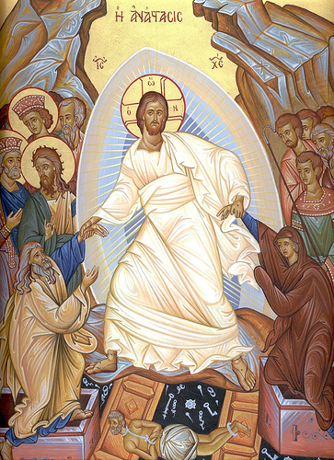
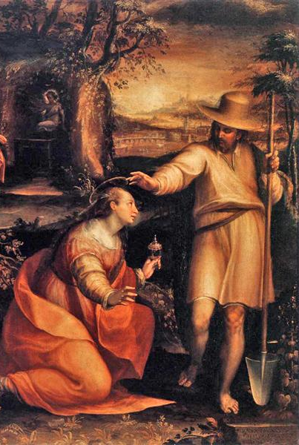
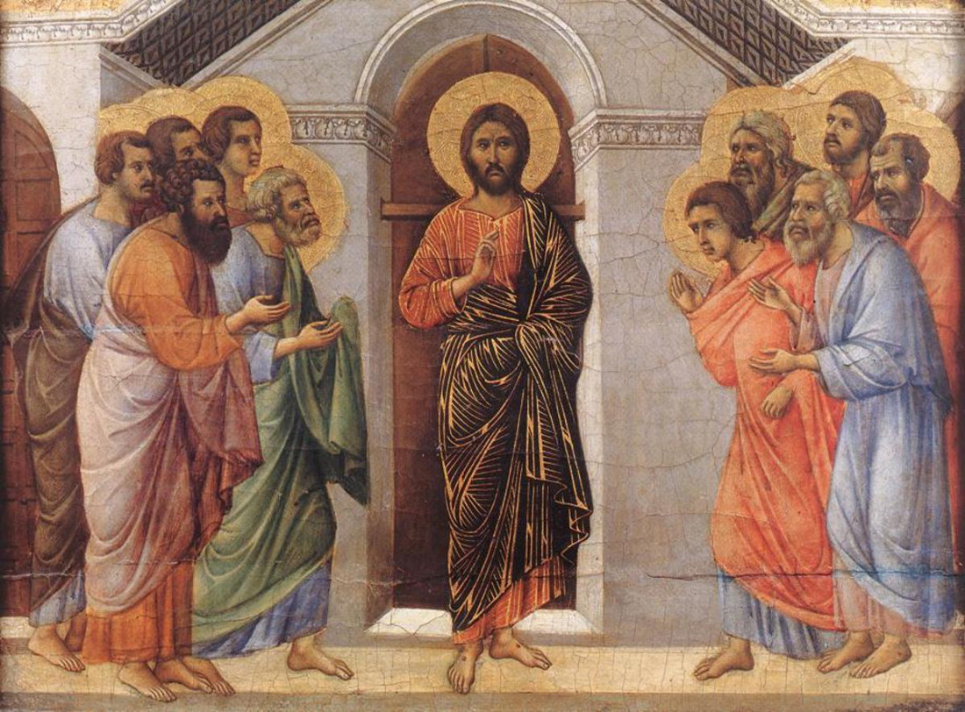
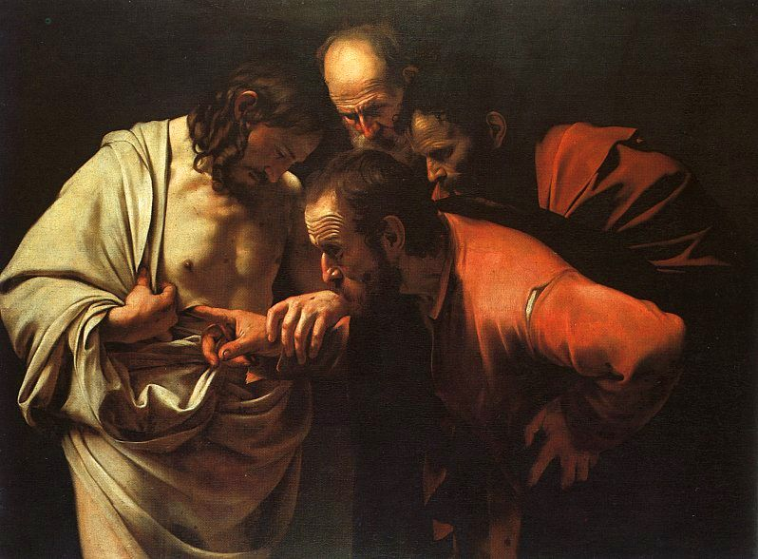
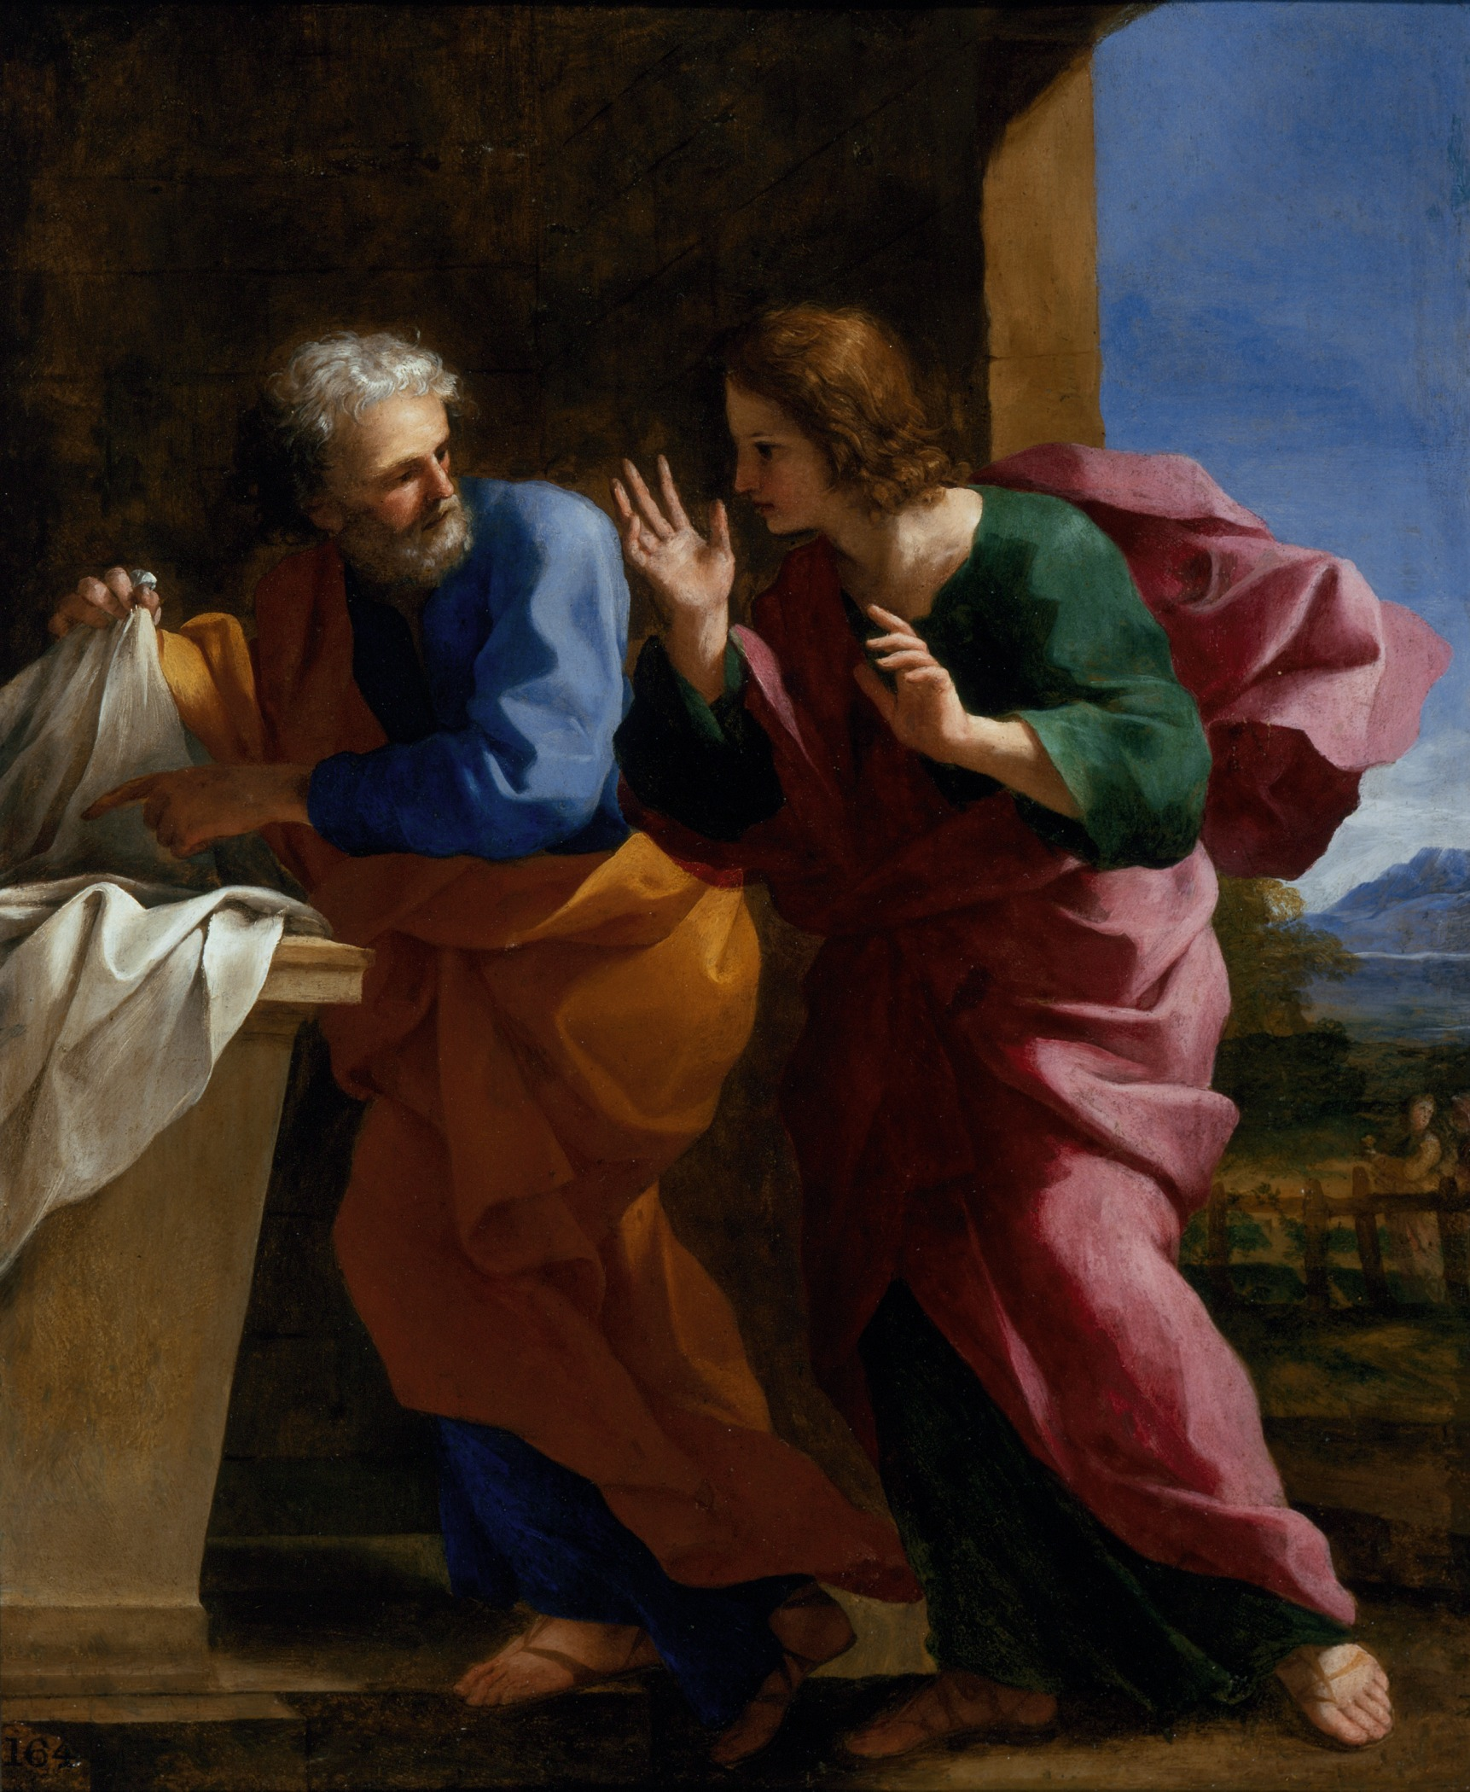
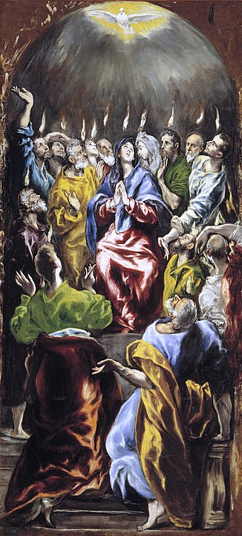
Via Lucis
The Stations of the Resurrection

Slide 2
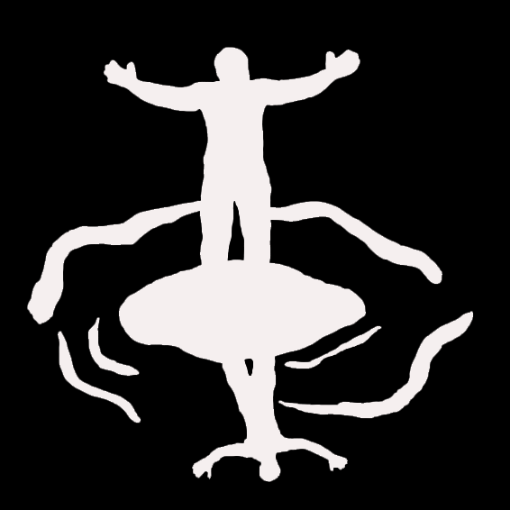
Introduction
All (Together): Alleluia, alleluia, alleluia. O sons and daughters, let us sing! The King of heaven the glorious King, Over death today rose triumphing, Alleluia!
The Sign of the Cross

Slide 3
Opening Reading
A Reading from St. Paul’s Letter to the Romans (6:3-11):
Do you not know that all of us who have been baptized into Christ Jesus were baptized into his death? Therefore we have been buried with him by baptism into death, so that, just as Christ was raised from the dead by the glory of the Father, so we too might walk in newness of life. For if we have been united with him in a death like his, we will certainly be united with him in a resurrection like his. We know that our old self was crucified with him so that the body of sin might be destroyed, and we might no longer be enslaved to sin. For whoever has died is freed from sin. But if we have died with Christ, we believe that we will also live with him. We know that Christ, being raised from the dead, will never die again; death no longer has dominion over him. The death he died, he died to sin, once for all; but the life he lives, he lived to God. So you also must consider yourselves dead to sin and alive to God in Christ Jesus.

Slide 4
Opening Reflection
Brothers and Sisters,
Let us walk this pilgrimage of faith, the Via Lucis, as daughters and sons of the light and as witnesses of the Risen Lord. Let us meditate upon the resurrection of Christ and discover the pathway of light that Christ blazes through our lives.

Slide 5
The 1st Station: Jesus Rises from the Dead
Leader: We adore You, O Christ and we praise You!
R/. Because by the Wood of the Cross and the Light of the Resurrection, You have redeemed the world!
Reading: The angel of the Lord said to the women: 'Do not be afraid! I know that you are seeking Jesus the crucified. He is not here, for He has been raised just as He said." (Matthew 28: 5b-6a).
Reflection: On the first day of the week, at the dawning of the new creation, Jesus arose from the dead. No one saw the event, yet like the apostles, we are called to be witnesses of this central faith event. The light and power of Christ's death and resurrection has become the pattern for our living. May we recognize Christ's dying and rising in our midst.

Slide 6
The 1st Station: Jesus Rises from the Dead
Prayer: This is the day, Lord God, that You have made! Raising Christ from the dead, and raising us with Christ, You have fashioned for Yourself a new people. As we hear the word that brings salvation, make our hearts burn within us. Through the presence of every friend and stranger, reveal to us the face of the One who had first to suffer, but who has entered now into glory, Jesus Christ, our Passover and our Peace, living and reigning with You, forever and ever. Amen.
All: Alleluia, alleluia, alleluia. That Easter morn, at break of day, The faithful women went their way To seek the tomb where Jesus lay, Alleluia!

Slide 7
The 2nd Station: The Disciples Discover the Empty Tomb
Leader: We adore You, O Christ and we praise You! R/.Because by the Wood of the Cross and the Light of the Resurrection, You have redeemed the world!
Reading: Then the other disciple also went in, the one who had arrived at the tomb first, and he saw and believed (John 20: 8).
Reflection: The empty tomb was not a proof of the resurrection, but rather a silent witness of the greatest event of our faith. Seeing the empty tomb, the disciples were motivated to seek the Risen Lord at work in their midst. They saw and believed in the continuing presence of the Lord of love. All the empty and lonely places of human life are precisely where the Lord wishes to work and be revealed.

Slide 8
The 2nd Station: The Disciples Discover the Empty Tomb
Prayer: God our Father, creator of all, today is the day of overwhelming joy. The Lord appeared to those who had begun to lose hope and opened their eyes to what the Scriptures foretold: that first He must die and then rise. May the Risen Lord breathe on our minds and open our eyes that we may know Him in the breaking of bread, and follow Him in His risen life. Grant this through Christ our Lord. Amen.
All: Alleluia, alleluia, alleluia. The dear belov'd apostle John Could faster than St. Peter run, Arriving first before the tomb. Alleluia.

Slide 9
The 3rd Station: The Risen Lord Appears to Mary Magdalene, Apostle to the Apostles
Leader: We adore You, O Christ and we praise You! R/. Because by the Wood of the Cross and the Light of the Resurrection, You have redeemed the world!
Reading: She turned around and saw Jesus there, but did not know it was Jesus. Jesus said to her, 'Woman, why are you weeping? Whom are you looking for?' She thought He was the gardener and said to Him, 'Sir, if you carried Him away, tell me where you laid Him, and I will take Him.' Jesus said to her, 'Mary!" She turned and said to Him in Hebrew, 'Rabbouni,' which means Teacher. Jesus said to her, 'Stop holding on to Me, for I have not yet ascended to the Father. But go to My brothers and tell them, 'I am going to My Father and your Father, to My God and your God.' Mary of Magdala went and announced to the disciples, 'I have seen the Lord,' and what He told her (John 20: 14b-18).
Reflection: In the fourth gospel, Mary Magdalen is given the mission to carry the good news of the resurrection to the apostles and the disciples. Mary had been in the company of Jesus and His followers, and is given the privilege to announce the hope of new life. She is known over the centuries as "the apostle to the Apostles." Jesus called her by name, gave her the eyes of faith, and called her to give a unique personal witness to her friends in the faith community.

Slide 10
The 3rd Station: The Risen Lord Appears to Mary Magdalene, Apostle to the Apostles
Prayer: God our Father, You will that all people to be saved and come to the knowledge of Your truth. Send workers into Your great harvest that the Gospel may be preached to every creature. May Your people, gathered together by the word of life and strengthened by the power of the sacraments, advance in the way of salvation. We ask this through Christ our Lord. Amen.
All: Alleluia, alleluia, alleluia. Not Magdalen, not Salome, Nor James' own mother then delay Embalming Jesus' corpse that day. Alleluia.

Slide 11
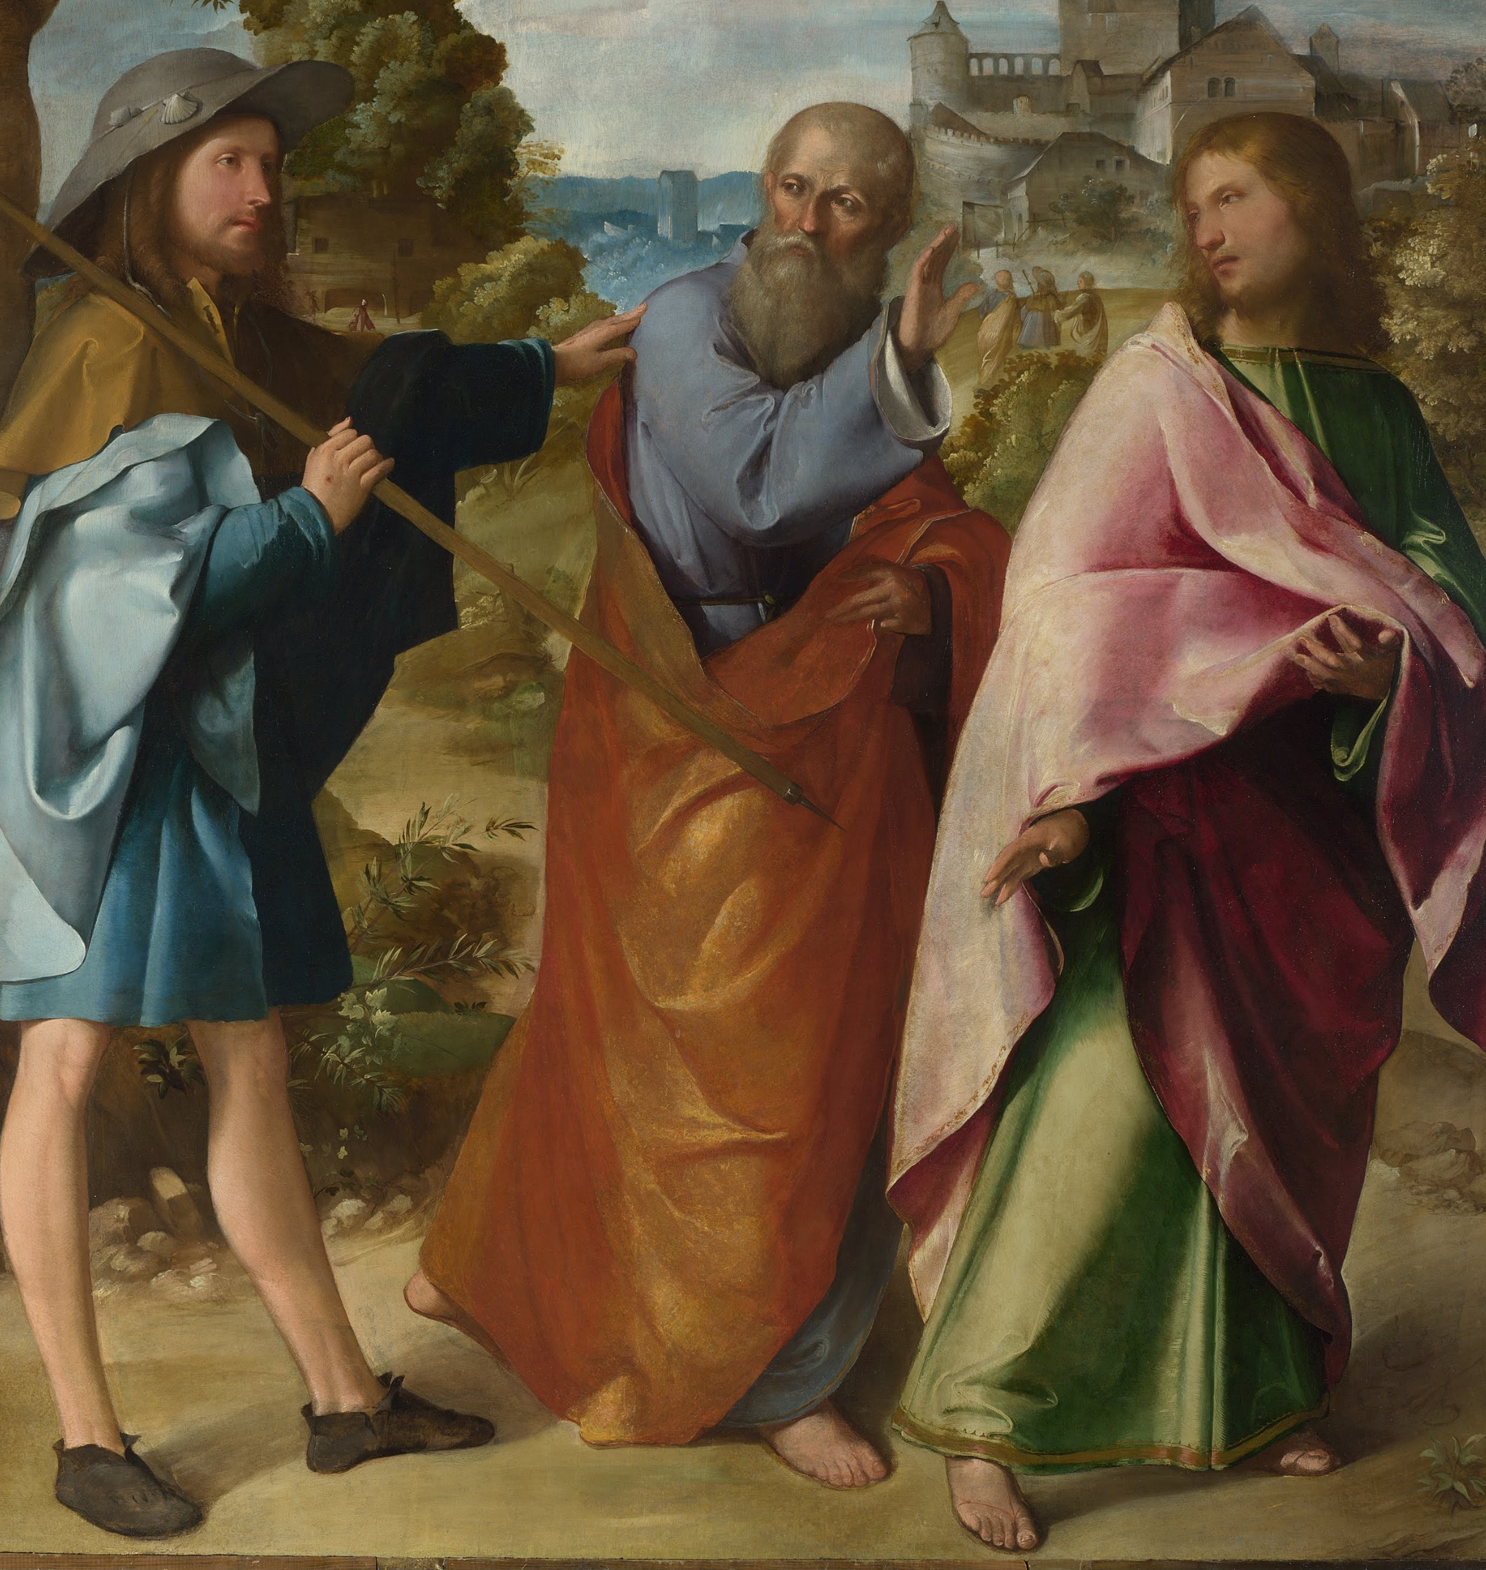
The 4th Station: The Risen Lord Appears on the Road to Emmaus
Leader: We adore You, O Christ and we praise You! R/: Because by the Wood of the Cross and the Light of the Resurrection, You have redeemed the world!
Reading: It happened that while they were conversing and debating, Jesus Himself drew near and walked with them, but their eyes were prevented from recognizing Him.... And He said to them, 'Oh, how foolish you are! How slow of heart to believe all that the prophets spoke! Was it not necessary that the Messiah should suffer these things and enter into His glory?' Then beginning with Moses and all the prophets, He interpreted to them what referred to Him in all the scriptures" (Luke 24: 15, 25-27).
Reflection: The Emmaus road is the story of the Christian life. These disciples were walking away from Jerusalem and the apostolic faith community in defeat and dejection. They had lost hope. We too, have moments of despair and desolation. The Risen Lord Jesus accompanies us along the road, even when we are moving in the wrong direction. Only the Lord can "break open" the Word in order to help us understand the stories of our lives, especially suffering, and read them in harmony with the pattern of the Scriptures. Only the Lord can rekindle our energy and our resolve to devote ourselves to what is most important in life.

Slide 12
The 4th Station: The Risen Lord Appears on the Road to Emmaus
Prayer: Lord God, as disciples on our pilgrimage, we implore Jesus Christ: stay with us, Lord. Open our hearts to true conversion and, as we have known the Lord in the breaking of the bread, so make us witnesses of a new humanity, renewed, reconciled and at peace in Your love. Send us as heralds of the repentance and forgiveness You offer to all in the name of Jesus, who lives and reigns with You, forever and ever. Amen.
All: Alleluia, alleluia, alleluia. That night the apostles met in fear; Amidst them came the Lord most dear, And said My peace be on all here. Alleluia.

Slide 13
The 5th Station: The Risen Lord is Recognized in the Breaking of the Bread
Leader: We adore You, O Christ and we praise You! R/: Because by the Wood of the Cross and the Light of the Resurrection, You have redeemed the world!
Reading: They urged Him, 'Stay with us, for it is nearly evening and the day is almost over.’ So He went in to stay with them. And it happened that while He was with them at table, He took bread, said the blessing, broke it, and gave it to them. With that, their eyes were opened and they recognized Him, but He vanished from their sight. Then they said to each other, 'Were not our hearts burning within us while He spoke to us on the way and opened the scriptures to us'" (Luke 24: 29-32).
Reflection: The encounter on the road leads to the table, the breaking of the bread and the total gift of self. Recognition of the Risen Lord is always linked with the Eucharist. At the heart of our Christian life is this meal of Word and Eucharist which we celebrate every Sunday. The Risen Lord presides over all our journeys, wishing to set our hearts on fire in generous service to all people in need, near and far. The gift we have received is the gift we share. Humbly, we set out on the various roads of our lives to respond to all the hungers of the human family.

Slide 14
The 5th Station: The Risen Lord is Recognized in the Breaking of the Bread
Prayer: You are truly blessed, O God of holiness: You accompany us with love as we journey through life. Blessed too, is Your Son, Jesus Christ, who is present among us, and whose love gathers us together. As once He did for His disciples, Christ now opens the Scriptures for us and breaks the bread. May the Eucharist we celebrate guide us to the fullness of Christ's life. We pray in the power of Christ's Spirit, forever and ever. Amen.
All: Alleluia, alleluia, alleluia. When Thomas, first the tidings heard, How they had seen the Risen Lord, He doubted the disciples' word. Alleluia.

Slide 15
The 6th Station: The Risen Lord Appears to the Community of Disciples
Leader: We adore You, O Christ and we praise You! R/: Because by the Wood of the Cross and the Light of the Resurrection, You have redeemed the world!
Reading: “Why are you troubled? And why do questions arise in your hearts? Look at My hands and My feet, that it is I Myself. Touch Me and see, because a ghost does not have flesh and bones as you can see I have,' And as He said this, He showed them His hands and His feet" (Luke 24: 38-40).
Reflection: The disciples on the road to Emmaus quickly returned to the other disciples in Jerusalem with "burning hearts." Their despair had been reversed and they were eager to convince the others that Jesus was alive. Jesus the Christ is always eager to gather the community of disciples at the table of faith and to show them that He has risen with His wounds glorified. All our wounds will one day be glorified. We seek to understand how the Risen Lord invites us to be "wounded healers," recognizing now that the Lord desires us to be ambassadors of reconciliation, while we ourselves are being forgiven and healed.

Slide 16
The 6th Station: The Risen Lord Appears to the Community of Disciples
Prayer: God of unchanging power and light, look with favor and mercy on the entire community of Your Church. Bring lasting salvation to the human family, so that the world may see the fallen lifted up, the old made new, and all things brought to perfection, through Him who is our origin, our Lord Jesus Christ who lives and reigns forever and ever. Amen.
All: Alleluia, alleluia, alleluia. My wounded side, O Thomas see; Behold My hands, My feet, said He Not faithless, but believing be. Alleluia.

Slide 17
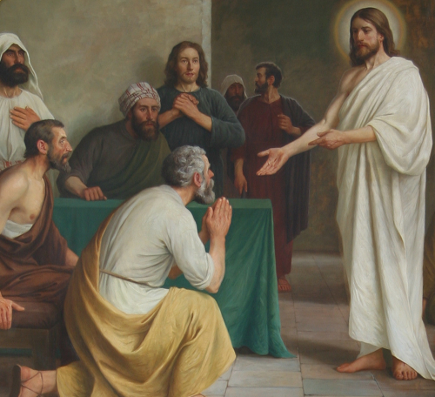
The 7th Station: The Risen Lord Breathes the Holy Spirit on the Apostles, giving peace and the power to forgive.
Leader: We adore You, O Christ and we praise You! R/:Because by the Wood of the Cross and the Light of the Resurrection, You have redeemed the world!
Reading: Jesus came and stood in their midst and said to them, 'Peace be with you'... The disciples rejoiced when they saw the Lord. Jesus said to them again, 'Peace be with you. As the Father has sent Me, so I send you.' And when He had said this, He breathed on them and said to them, 'Receive the Holy Spirit. Whose sins you forgive are forgiven them, and whose sins you retain are retained'" (John 20: 19b, 20b-23).
Reflection: Even though the doors of the Upper Room were bolted shut, the Risen Lord pierced through all fear and united the hearts of the disciples with the gift of peace. Deep inner peace is the root and source of the peace and joy that the world cannot give. The Risen Lord calls us to seek peace always through a non-violent commitment to conflict resolution and thus transform the world, relationship by relationship.

Slide 18
The 7th Station: The Risen Lord Breathes the Holy Spirit on the Apostles, giving peace and the power to forgive.
Prayer: God of perfect peace, violence and cruelty can have no part of You. May those who are at peace with one another hold fast to the good will that unites them; may those who are enemies forget their hatred and be healed. We ask this through Christ our Lord. Amen.
All: Alleluia, alleluia, alleluia. No longer Thomas then denied, He saw the feet, the hands, the side; You are my Lord and God, he cried, Alleluia!

Slide 19
The 8th Station: The Risen Lord Strengthens the Faith of Thomas
Leader: We adore You, O Christ and we praise You! R/: Because by the Wood of the Cross and the Light of the Resurrection, You have redeemed the world!
Reading: "Thomas…was not with them when Jesus came.... Thomas said, 'Unless I see the mark of the nails in His hands and put my finger into the nail marks and put my hand into His side, I will not believe'...Jesus came...and stood in their midst and said, 'Peace be with you.' Then He said to Thomas, 'Put your finger here and see My hands, and bring your hand and put it into My side, and do not be unbelieving, but believe'…Blessed are those who do not see and yet believe." (John 20: 24-29).
Reflection: The story of Thomas is important because it is through Thomas' example that we realize that doubt can be a part of faith. Too easily we call him "Doubting Thomas," and forgetting that after examining the nail marks, he fully embraced the Risen One as his Lord and Savior. Thomas' doubt was transformed into a lively faith. We too, are called to believe, knowing full well that our faith may be tested by doubt and fear. As disciples who desire an ever-deeper faith, we are patient and understanding with those who are struggling, searching and seeking like Thomas.

Slide 20
The 8th Station: The Risen Lord Strengthens the Faith of Thomas
Prayer: Heavenly Father and God of mercy, we no longer look for Jesus among the dead, for He is alive and has become the Lord of life. From the waters of death You raise us up with Him and renew Your gift of life within us. Increase in our minds and hearts the risen life we share with Christ and help us to grow as Your people toward the fullness of eternal life with You. We ask this through Christ our Lord. Amen.
All: Alleluia, alleluia, alleluia. How blest are they who have not seen, And yet whose faith has constant been For they eternal life shall win. Alleluia!

Slide 21
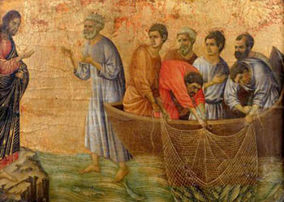
The 9th Station: The Risen Lord Eats with the Disciples
Leader: We adore You, O Christ and we praise You! R/: Because by the Wood of the Cross and the Light of the Resurrection, You have redeemed the world!
Reading: "Jesus said to them, 'Bring some of the fish you just caught.' So Simon Peter went over and dragged the net ashore full of one hundred fifty-three large fish. Even though there were so many, the net was not torn. Jesus said to them, 'Come, have breakfast.' And none of His disciples dared to ask Him, 'Who are You?' because they realized it was the Lord" (John 21: 10-12).
Reflection: After the crucifixion, the apostles returned to their former way of life. Out on the familiar Sea of Galilee, these expert fishers find themselves ineffective and baffled because not even a single fish was caught. From the shore, the Risen Lord guides them and directs their nets until they are filled to overflowing. As He prepares breakfast for them, He nourishes their hearts and promises them that they can also be fed by making disciples in His name. He calls them to an entirely new way of fishing—fishing for people.

Slide 22
The 9th Station: The Risen Lord Eats with the Disciples
Prayer: Father in heaven, author of all truth, a people once in darkness has listened to Your Word and followed Your Son as He rose from the tomb. Hear the prayer of this newborn people and strengthen Your Church to answer Your call. May we rise and come forth into the light of day to stand in Your presence until eternity dawns. We ask this through Christ our Lord. Amen.
All: Alleluia, alleluia, alleluia. On Sunday morn at break of day The sad disciples went their way To see the tomb where Jesus lay. Alleluia.

Slide 23
The 10th Station: The Risen Lord Forgives Peter
Leader: We adore You, O Christ and we praise You! R/: Because by the Wood of the Cross and the Light of the Resurrection, You have redeemed the world! Reading: "When they had finished breakfast, Jesus said to Simon Peter, 'Simon, son of John, do you love Me more than these?'... Peter was distressed that Jesus had said to him a third time, 'Do you love Me?' and he said to Him, 'Lord, You know everything, You know that I love You.' Jesus said to him, 'Feed my sheep.... Follow Me' " (John 21: 15, 17b, 19b).
Reflection: The Risen Lord directs His attention to Peter whose embarrassing three-fold denial was still ringing in his heart. The questions posed by Jesus help Peter to find reconciliation and to embrace his new mission to tend and feed the sheep. Their encounter reminds us that forgiveness is always available, even for the most serious of mistakes we can make. This warm embrace of forgiveness strengthens our resolve to be reconcilers and healers in the Spirit of Jesus. Only love can overcome guilt and deception. Only love and forgiveness can make us whole.

Slide 24
The 10th Station: The Risen Lord Forgives Peter
Prayer: Father, fill our hearts with the fire of Your love and the desire to ensure justice for our brothers and sisters. By sharing the good things You give us, may we secure justice and equality for every human being, an end to all division, and a human society built on love and peace. Grant this through Christ our Lord.
All: Alleluia, alleluia, alleluia. An angel clad in white they see, Who sat and spoke unto the three, Your Lord has gone to Galilee, Alleluia!

Slide 25
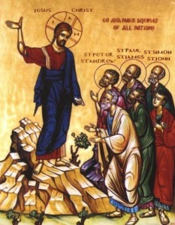
The 11th Station: The Risen Lord Sends the Disciples into the World
Leader: We adore You, O Christ and we praise You! R/: Because by the Wood of the Cross and the Light of the Resurrection, You have redeemed the world! Reading: "'Go therefore, and make disciples of all the nations, baptizing them in the name of the Father, and of the Son, and of the Holy Spirit, teaching them to observe all that I have commanded you. And behold, I am with you always, until the end of the age'" (Matthew 28: 19-20).
Reflection: From the mountaintop, the Risen Lord gives the "Great Commission" to the disciples to reach out to the ends of the earth. We realize that we are the recipients of this faith-filled mission: our ancestors embraced the faith of the apostles, who were the original witnesses of the resurrection. The greatest response we can give to such a legacy is our dedication to a new evangelization of our contemporary culture. We must allow the Risen Lord to reinvigorate our whole way of living, helping us to re-evaluate every aspect of our lives with the values of the Kingdom of God.

Slide 26
The 11th Station: The Risen Lord Sends the Disciples into the World
Prayer: God of all creation, whose mighty power raised Jesus from the dead, be present to this community of disciples whom You have called to the hope of a glorious inheritance among the saints. Strengthen us in the power of the Spirit to go and make disciples of all nations, to obey everything that Jesus Christ has commanded us, and to know that He is with us always until the end of the age, interceding on our behalf, living and reigning with You in the power of the Holy Spirit, now and forevermore. Amen.
All: Alleluia, alleluia, alleluia. And we with Holy Church unite, As evermore is just and right, in glory to the King of light. Alleluia.

Slide 27
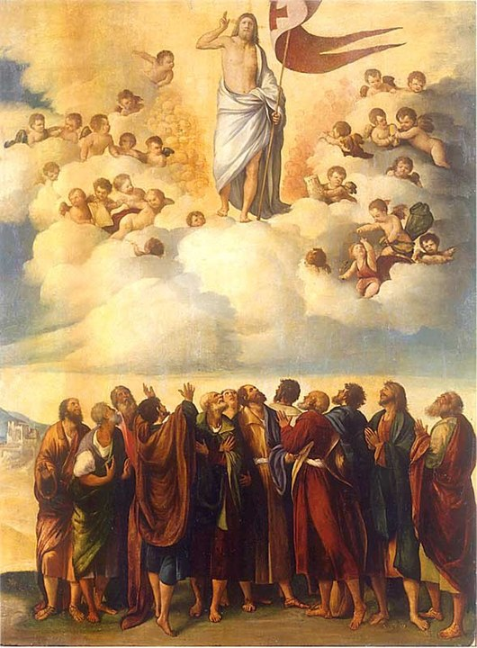
The 12th Station: The Ascension
Leader: We adore You, O Christ and we praise You! R/: Because by the Wood of the Cross and the Light of the Resurrection, You have redeemed the world!
Reading: "So then the Lord Jesus, after He spoke to them, was taken up into heaven and took His seat at the right hand of God. But they went forth and preached everywhere, while the Lord worked with them and confirmed the word through accompanying signs" (Mark 16: 19-20).
Reflection: The Scriptures do not portray the Ascension as a day of sadness. While still looking up at the skies, the disciples were consoled by the continuing presence of the Lord. They return to the familiar surroundings of the Upper Room, with Mary, the mother of the Lord, to pray in anticipation of their mission. In this "original novena," we continue to implore the Risen Lord to be the center of our lives and to keep us focused as a jubilant pilgrim people.

Slide 28
The 12th Station: The Ascension
Prayer: Eternal God, clothe us now with Your power. With the eyes of our hearts enlightened, may we come to understand the immeasurable greatness of Your power at work in us who believe. In that strength, may we boldly pronounce the Good News of our salvation to everyone. We ask this through Christ our Lord. Amen.
All: Alleluia, alleluia, alleluia. Our humble thanks to God let's show And fitting praise on Him bestow For Paschal blessings here below. Alleluia.

Slide 29
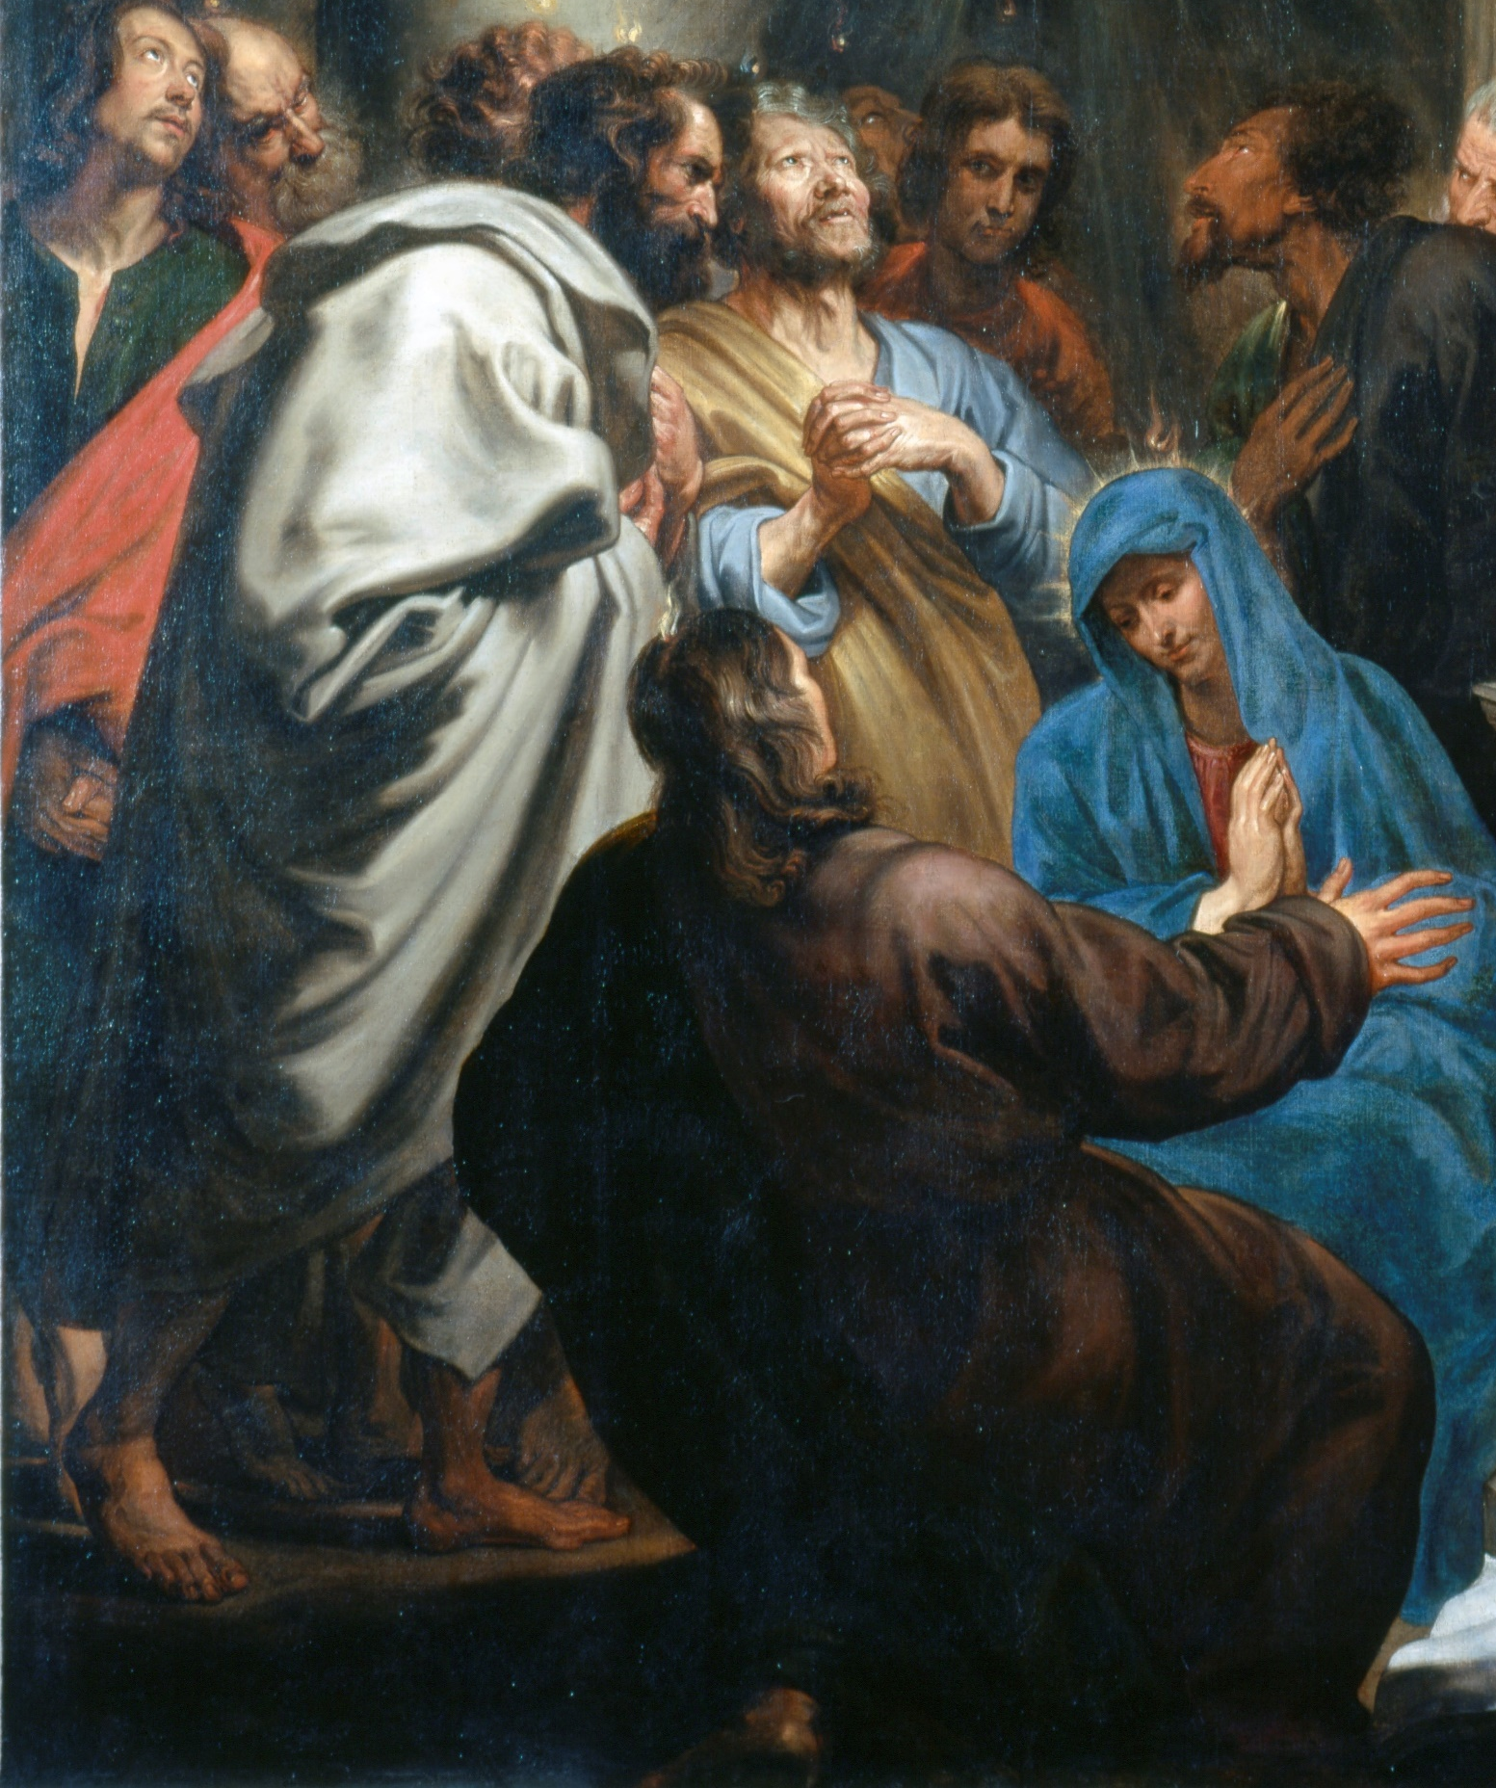
The 13th Station: Mary and the Apostles Keep Vigil in the Upper Room
Leader: We adore You, O Christ and we praise You! R/: Because by the Wood of the Cross and the Light of the Resurrection, You have redeemed the world! Reading: "When they entered the city, they went to the upper room where they were staying.... All [the apostles] devoted themselves with one accord to prayer, together with some women, and Mary, the mother of Jesus, and His brothers" (Acts 1: 13a, 14).
Reflection: Throughout the history of the Church, there have been apostolic movements dedicated to prayerful contemplation, and others resulting in transforming action. As we have crossed the threshold into a new millennium, we look to the "Upper Room" as a symbolic place where we return over and over again, so that we can become "contemplatives in action." As persons who are both prayerful and energetic in service to the Gospel, we must always keep vigil for the advent of the Risen Lord, with the flame of faith alive in our hearts. Only the Lord can refresh our spirits and renew us in the ministries that flow from our Baptism and Confirmation.

Slide 30
The 13th Station: Mary and the Apostles Keep Vigil in the Upper Room
Prayer: Father most holy, see Your Church gathered here in prayerful worship like the first disciples and Mary in the Upper Room. Grant that we may accomplish, in the joy of the Holy Spirit, all that You give us to do in the world. May we gladly share in Christ's sufferings so as to rejoice when His glory is revealed. We ask this through Christ our Lord. Amen.
All: Alleluia, alleluia, alleluia. On this most holy day of days, To God your hearts and voices raise, In laud and jubilee and praise. Alleluia!

Slide 31
The 14th Station: The Descent of the Holy Spirit
Leader: We adore You, O Christ and we praise You! R/: Because by the Wood of the Cross and the Light of the Resurrection, You have redeemed the world! Reading: Suddenly there came from the sky a noise like a strong driving wind, and it filled the entire house. Then there appeared to them tongues as of fire, which parted and came to rest on each one of them. And they were all filled with the Holy Spirit and began to speak in different tongues, as the Spirit enabled them to proclaim" (Acts 2: 2-4).
Reflection: The power of the Holy Spirit drives the disciples from the Upper Room into the streets and marketplace. The Spirit compels them to take the message everywhere, in places familiar and unfamiliar, not stopping until they reach the ends of the world. We have been clothed with the same Spirit. We are called to be evangelizers and witnesses, near and far, wherever we go. The Spirit always goes before us, preparing the way and strengthening our hearts to be generous servants of the Risen Lord who ever guides us. Pentecost is an enduring and continuing event. We implore the Holy Spirit to renew the face of the earth by renewing us.

Slide 32
The 14th Station: The Descent of the Holy Spirit
Prayer: Father in heaven, through this spiritual journey, You have reminded us of the fullness of the mystery of Your revealed love. See Your people gathered in prayer, open to receive the Spirit's flame. May it come to rest in our hearts and disperse the divisions of word and tongue. With one voice and one song, may we praise Your name in joy and thanksgiving. Grant this through Christ our Lord, and in the power of the Spirit, both now and forevermore. Amen.
All: Alleluia, alleluia, alleluia.
O sons and daughters of the Lord, The King of glory, King adored, From death to life has been restored. Alleluia.

Slide 33
Conclusion
Reading: " ... Jesus Himself, through them, sent forth from east to west the sacred and imperishable proclamation of eternal salvation. Amen" (Mark 16:8, the Shorter Ending).
Reflection: Through the Via Lucis, we have shared our pilgrim journey with the Risen Lord. As servants and witnesses of Christ, let us now pray in the way our Savior taught us:
All Together: "Our Father…“
Prayer: Lord, may everything we do, begin with Your inspiration, continue with Your help, and reach perfection under Your guidance. We ask this through Christ, our Risen Lord. Amen.

Slide 34
Image Credits
Icon of the Resurrection
St. John and St. Peter at Christ’s Tomb by Giovanni Francesco Romanelli
Noli Me Tangere by Lavinia Fontana
The Road to Emmaus by Altobello Melone
Supper at Emmaus by Matthian Stom
Christ Appears to the Apostles Behind Closed Doors by Duccio di Buoninsegna
Jesus Returns to His Disciples by Poul Steffensen
The Incredulity of Saint Thomas by Caravaggio
The Miraculous Catch of Fish by Duccio

Slide 35
Image Credits
Christ’s Charge to Peter by Raphael
Icon of the Great Commission
The Ascension by Dosso Dossi
Pouring of the Holy Ghost by Anthonis von Dyck
Pentecost by El Greco

