Slide 1
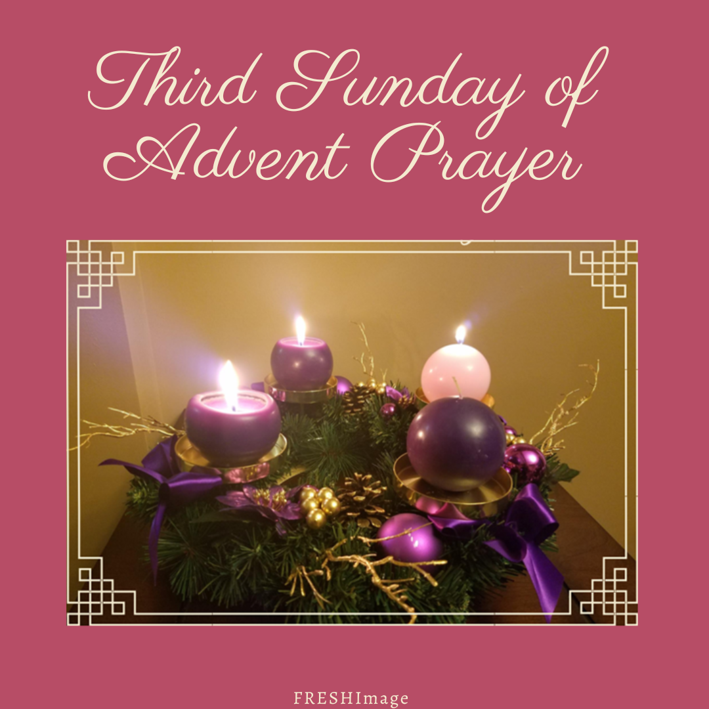

Slide 2

Please Light the First Two Candles on Your Advent Wreath.

Slide 3
Begin with the Sign of the Cross
Leader: Our help is in the name of the Lord.
R/. Who made heaven and earth.

Slide 4
Listen to the words of St. Paul to the Philippians (4:4-7):
Rejoice in the Lord always! I say it again. Rejoice! Everyone should see how unselfish you are. The Lord is near. Dismiss all anxiety from your minds. Present your needs to God in every form of prayer and in petitions full of gratitude. Then God’s own peace, which is beyond all understanding, will stand guard over your hearts and minds, in Christ Jesus.
Reader: The word of the Lord
R/. Thanks be to God.

Slide 5
Responsory
Your light will come, Jerusalem; the Lord will dawn on you in radiant beauty.
R/. Your light will come, Jerusalem; the Lord will dawn on you in radiant beauty .
You will see his glory within you.
R/. The Lord will dawn on you in radiant beauty.
Glory to the Father and to the Son and to the Holy Spirit
R/. Your light will come, Jerusalem; the Lord will dawn on you in radiant beauty.

Slide 6
Please Light the Third Candle on Your Advent Wreath.

Slide 7
Closing Prayer
O God, who see how your people faithfully await the feast of the Lord’s Nativity, enable us, we pray, to attain the joys of so great a salvation and to celebrate them always with solemn worship and glad rejoicing. Through our Lord Jesus Christ, your Son, who lives and reigns with you in the unity of the Holy Spirit, one God, for ever and ever.
(Collect from the Office of Readings, Third Sunday of Advent)

Slide 8
Closing Verses from O Come, O Come, Emmanuel
O come, O Key of David, come
and open wide our heavenly home.
Mark safe the way that leads on high
and close the path to misery.

Slide 9
O come, Thou Dayspring from on high,
And cheer us by Thy drawing nigh;
Disperse the gloomy clouds of night
And death’s dark shadow put to flight.

