Slide 1
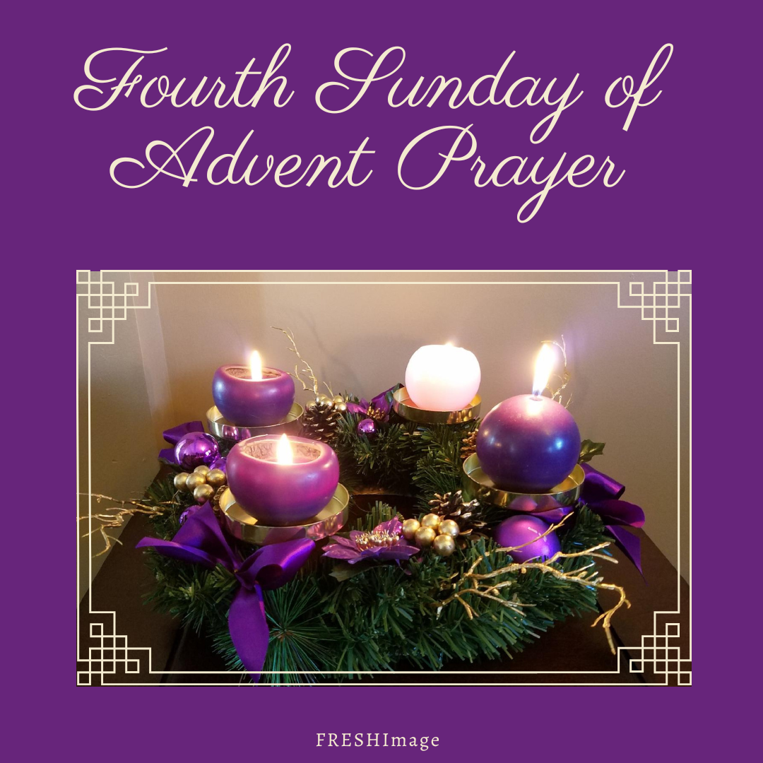

Slide 2

Please Light the First Three Candles on Your Advent Wreath.

Slide 3
Begin with the
Sign of the Cross
Leader: Our help is in the name of the Lord.
R/. Who made heaven and earth.

Slide 4
Listen to the words of the Prophet Isaiah (11:1-5):
A shoot shall sprout from the stump of Jesse, and from his roots a bud shall blossom. The spirit of the Lord shall rest upon him: a spirit of wisdom and of understanding, a spirit of counsel and of strength, a spirit of knowledge and of fear of the Lord, and his delight shall be the fear of the Lord. Not by appearance shall he judge, nor by hearsay shall he decide, but he shall judge the poor with justice, and decide aright for the land’s afflicted. He shall strike the ruthless with the rod of his mouth, and with the breath of his lips he shall slay the wicked. Justice shall be the band around his waist, and faithfulness a belt upon his hips.
Reader: The word of the Lord
R/. Thanks be to God.

Slide 5
Responsory
Come and set us free, Lord God of power and might.
R/. Come and set us free, Lord God of power and might.
Let your face shine upon us and we shall be saved.
R/. Lord God of power and might.
Glory to the Father and to the Son and to the Holy Spirit
R/. Come and set us free, Lord God of power and might.

Slide 6
Please Light the Fourth Candle on Your Advent Wreath.

Slide 7
Closing Prayer
Father, all-powerful God,
your eternal Word took flesh on our earth when the Virgin Mary placed her life at the service of your plan.
Lift our minds in watchful hope
to hear the voice which announces his glory
and open our minds to receive the Spirit
who prepares us for his coming.
We ask this through Christ our Lord.
(Alternative Prayer from Evening Prayer II, Fourth Sunday of Advent)

Slide 8
Closing Verses from
O Come, O Come, Emmanuel
O come, desire of nations, bind
in one the hearts of humankind;
bid ev’ry sad division cease
and be thyself our Prince of peace.
Rejoice! Rejoice Emmanuel
shall come to thee, O Israel.

Slide 9
O come, O come, Emmanuel,
And ransom captive Israel,
That mourns in lonely exile here
Until the Son of God appear.
Rejoice! Rejoice! Emmanuel
Shall come to thee, O Israel.

