Slide 1
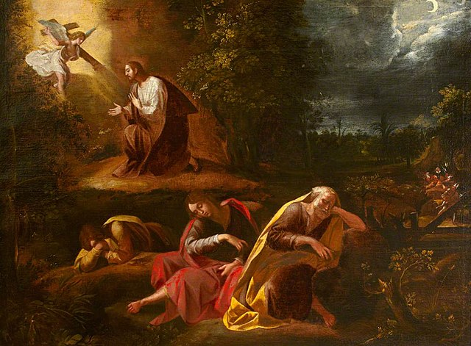
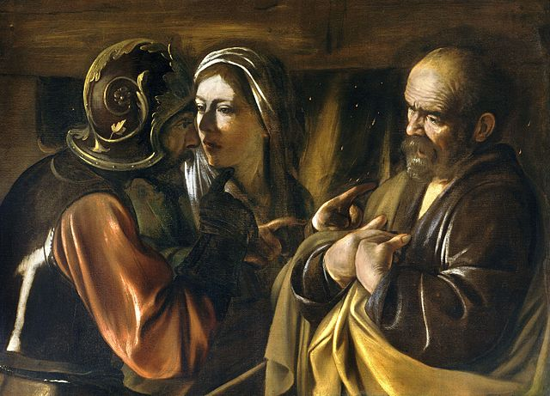
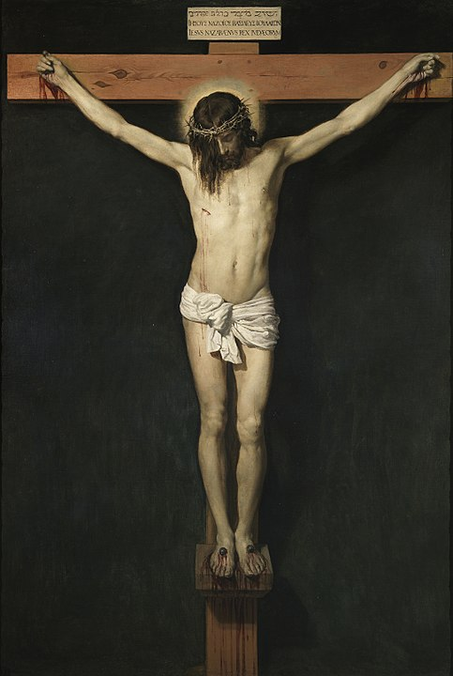
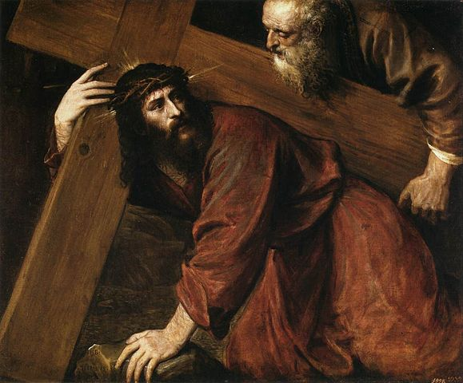
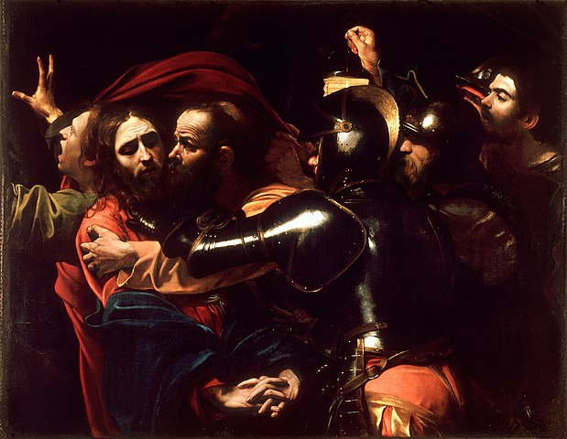
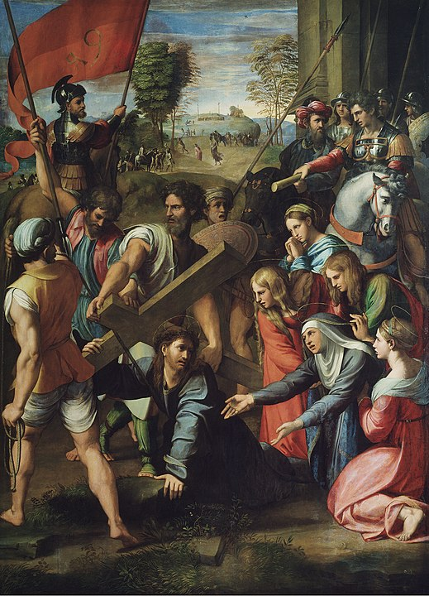
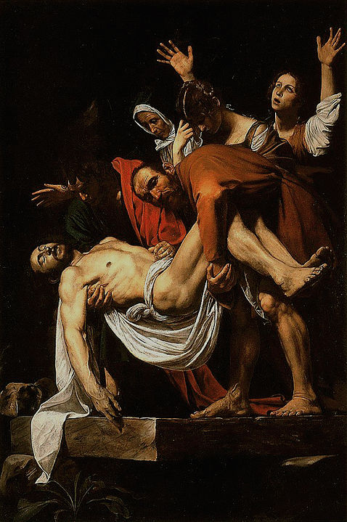
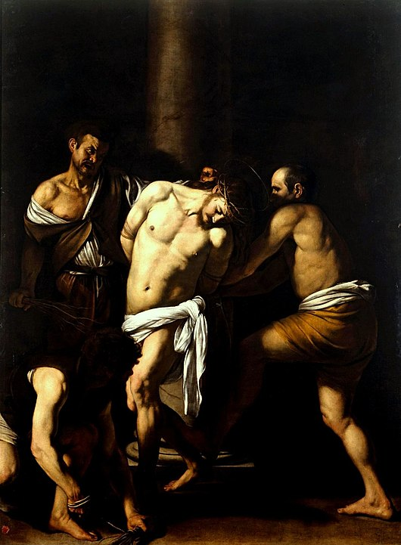
Scriptural Stations of the Cross

Slide 2
Opening Prayer
Sign of the Cross
Leader: God of power and mercy, in love you sent your Son that we might be cleansed of sin and live with you forever. Bless us as we gather to reflect on his suffering and death that we may learn from his example that we should go. We ask this through that same Christ our Lord.
R/. Amen.

Slide 3
1st Station: Jesus in the Garden of Gethsemane
Leader: We adore you, O Christ, and we bless you.
R/. Because by your holy Cross you have redeemed the world.
Reader: Then Jesus came with them to a place called Gethsemane, and he said to his disciples, “Sit here while I go over there and pray.” He took along Peter and the two sons of Zebedee, and began to feel sorrow and distress. Then he said to them, “My soul is sorrowful even to death. Remain here and keep watch with me.” He advanced a little and fell prostrate in prayer, saying, “My Father, if it is possible, let this cup pass from me; yet, not as I will, but as you will.” When he returned to his disciples he found them asleep. He said to Peter, “So you could not keep watch with me for one hour? Watch and pray that you may not undergo the test. The spirit is willing, but the flesh is weak.” -Mt 26:36-41
Leader: Lord, grant us your strength and wisdom, that we may seek to follow your will in all things.
R/. Lord Jesus, help us walk in your steps.

Slide 4
2nd Station: Jesus, Betrayed by Judas, is Arrested
Leader: We adore you, O Christ, and we bless you.
R/. Because by your holy Cross you have redeemed the world.
Reader: Then, while [Jesus] was still speaking, Judas, one of the Twelve, arrived, accompanied by a crowd with swords and clubs, who had come from the chief priests, the scribes, and the elders. His betrayer had arranged a signal with them, saying, “the man I shall kiss is the one; arrest him and lead him away securely.” He came and immediately went over to him and said, “Rabbi.” And he kissed him. At this they laid hands on him and arrested him. -Mk 14: 43-46
Leader: Lord, grant us the courage of our convictions that our lives may faithfully reflect the Good News you bring.
R/. Lord Jesus, help us walk in your steps.

Slide 5
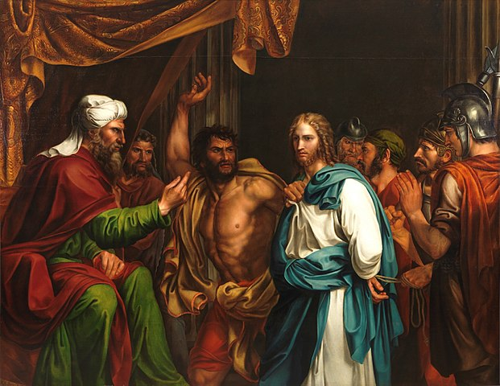
3rd Station: Jesus is Condemned by the Sanhedrin
Leader: We adore you, O Christ, and we bless you.
R/. Because by your holy Cross you have redeemed the world.
Reader: When day came the council of elders of the people met, both chief priests and scribes, and they brought him before their Sanhedrin. They said, “If you are the Messiah, tell us,” but he replied to them, “If I tell you, you will not believe, and if I question, you will not respond. But from this time on the Son of Man will be seated at the right hand of the power of God.” They all asked, “Are you then the Son of God?” He replied to them, “You say that I am.” Then they said, “What further need have we for testimony? We have heard it from his own mouth.” -Lk 22: 66-71
Leader: Lord, grant us your sense of righteousness that we may never cease to work to bring about the justice of the kingdom that you promised.
R/. Lord Jesus, help us walk in your steps.

Slide 6
4th Station: Jesus is Denied by Peter
Leader: We adore you, O Christ, and we bless you.
R/. Because by your holy Cross you have redeemed the world.
Reader: Now Peter was sitting outside in the courtyard. One of the maids came over to him and said, “You too were with Jesus the Galilean.” But he denied it in front of everyone, saying, “I do not know what you are talking about!” As he went out to the gate, another girl saw him and said to those who were there, “This man was with Jesus the Nazorean.” Again he denied it with an oath, “I do not know the man!” A little later the bystanders came over and said to Peter, “Surely you too are one of them; even your speech gives you away.” At that he began to curse and to swear, “I do not know the man.” And immediately a cock crowed. Then Peter remembered the word that Jesus had spoken: “Before the cock crows you will deny me three times.” He went out and began to weep bitterly. -Mt 26: 69-75
Leader: Lord, grant us the gift of honesty that we may not fear to speak the truth even when difficult.
R/. Lord Jesus, help us walk in your steps.

Slide 7
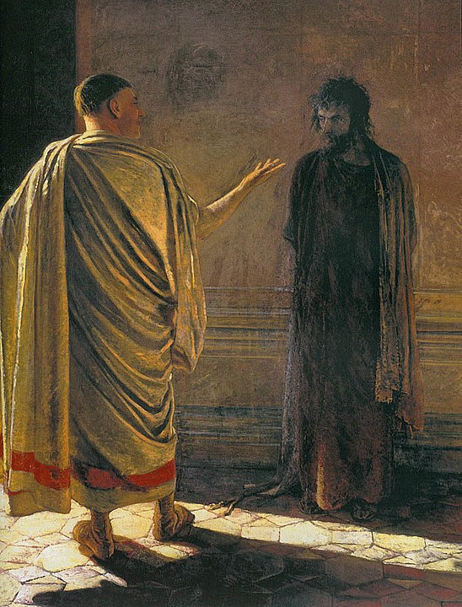
5th Station: Jesus is Judged by Pilate
Leader: We adore you, O Christ, and we bless you.
R/. Because by your holy Cross you have redeemed the world.
Reader: The chief priests with the elders and the scribes, that is, the whole Sanhedrin, held a council. They bound Jesus, led him away, and handed him over to Pilate. Pilate questioned him, “Are you the king of the Jews?” He said to him in reply, “You say so.” The chief priests accused him of many things. Again Pilate questioned him, “Have you no answer? See how many things they accuse you of.” Jesus gave him no further answer, so that Pilate was amazed.... Pilate, wishing to satisfy the crowd, released Barrabas... [and] handed [Jesus] over to be crucified. -Mk 15: 1-5, 15
Leader: Lord, grant us discernment that we may see as you see, not as the world sees.
R/. Lord Jesus, help us walk in your steps.

Slide 8
6th Station: Jesus is Scourged and Crowned with Thorns
Leader: We adore you, O Christ, and we bless you.
R/. Because by your holy Cross you have redeemed the world.
Reader: Then Pilate took Jesus and had him scourged. And the soldiers wove a crown out of thorns and placed it on his head, and clothed him in a purple cloak, and they came to him and said, “Hail, King of the Jews!” And they struck him repeatedly. -Jn 19: 1-3
Leader: Lord, grant us patience in times of suffering that we may offer our lives as a sacrifice of praise.
R/. Lord Jesus, help us walk in your steps.

Slide 9
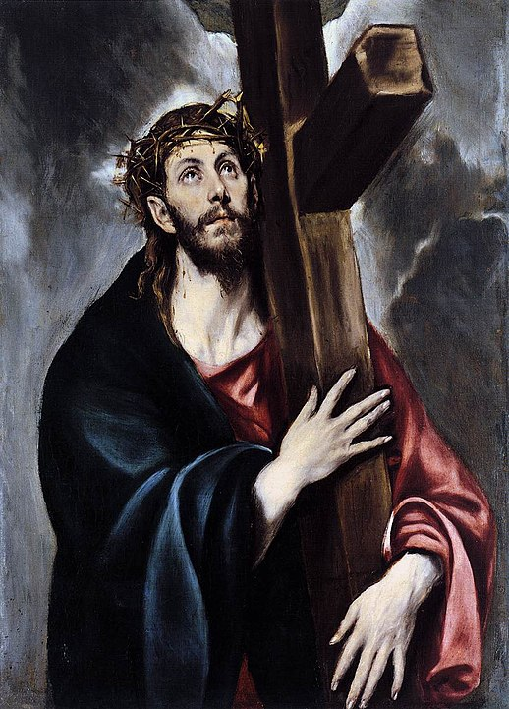
7th Station: Jesus Bears the Cross
Leader: We adore you, O Christ, and we bless you.
R/. Because by your holy Cross you have redeemed the world.
Reader: When the chief priests and the guards saw [Jesus] they cried out, “Crucify him, crucify him!” Pilate said to them, “Take him yourselves and crucify him. I find no guilt in him”... They cried out, “Take him away, take him away! Crucify him!” Pilate said to them, “Shall I crucify your king?” The chief priests answered, “We have no king but Caesar.” Then he handed him over to them to be crucified. So they took Jesus, and carrying the cross himself he went out to what is called the Place of the Skull, in Hebrew, Golgotha. -Jn 19: 6, 15-17
Leader: Lord, grant us strength of purpose that we may faithfully bear our crosses each day.
R/. Lord Jesus, help us walk in your steps.

Slide 10
8th Station: Jesus is Helped by Simon the Cyrenian to Carry the Cross
Leader: We adore you, O Christ, and we bless you.
R/. Because by your holy Cross you have redeemed the world.
Reader: They pressed into service a passer-by, Simon, a Cyrenian, who was coming in from the country, the father of Alexander and Rufus, to carry his cross. -Mk 15: 21 Leader: Lord, grant us willing spirits that we may be your instruments on earth.
R/. Lord Jesus, help us walk in your steps.

Slide 11
9th Station: Jesus Meets the Women of Jerusalem
Leader: We adore you, O Christ, and we bless you.
R/. Because by your holy Cross you have redeemed the world.
Reader: A large crowd of people followed Jesus, including many women who mourned and lamented him. Jesus turned to them and said, “Daughters of Jerusalem, do not weep for me; weep instead for yourselves and for your children, for indeed, the days are coming when people will say, ‘Blessed are the barren, the wombs that never bore and the breasts that never nursed.’ At that time, people will say to the mountains, ‘Fall upon us!’ and to the hills, ‘Cover us!’ for if these things are done when the wood is green what will happen when it is dry?” -Lk 23: 27-31 Leader: Lord, grant us gentle spirits that we may comfort those who mourn.
R/. Lord Jesus, help us walk in your steps.

Slide 12
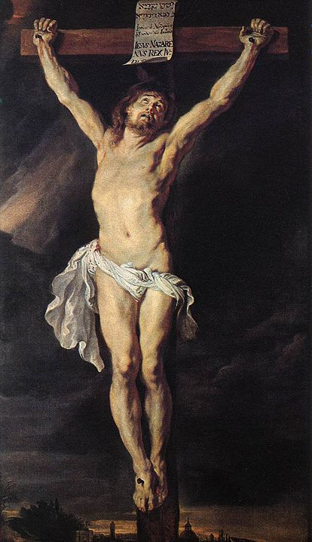
10th Station: Jesus is Crucified
Leader: We adore you, O Christ, and we bless you.
R/. Because by your holy Cross you have redeemed the world.
Reader: When they came to the place called the Skull, they crucified him and the criminals there, one on his right, the other on his left. Then Jesus said, “Father, forgive them, they know not what they do.” -Lk 23: 33-34 Leader: Lord, grant us merciful hearts that we may bring your reconciliation and forgiveness to all.
R/. Lord Jesus, help us walk in your steps.

Slide 13
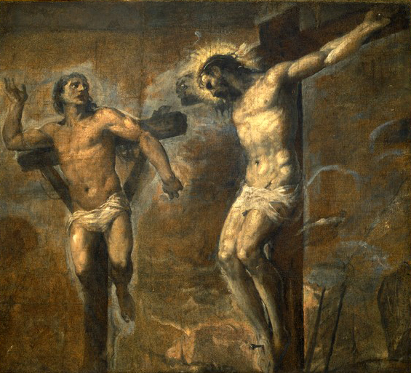
11th Station: Jesus Promises His Kingdom to the Good Thief
Leader: We adore you, O Christ, and we bless you.
R/. Because by your holy Cross you have redeemed the world.
Reader: Now one of the criminals hanging there reviled Jesus, saying, “Are you not the Messiah? Save yourself and us.” The other, however, rebuking him, said in reply, “Have you no fear of God, for you are subject to the same condemnation? And indeed, we have been condemned justly, for the sentence we received corresponds to our crimes, but this man has done nothing criminal.” Then he said, “Jesus, remember me when you come into your kingdom.” He replied to him, “Amen, I say to you, today you will be with me in Paradise.” -Lk 23: 39-43 Leader: Lord, grant us perseverance that we may never stop seeking you.
R/. Lord Jesus, help us walk in your steps.

Slide 14
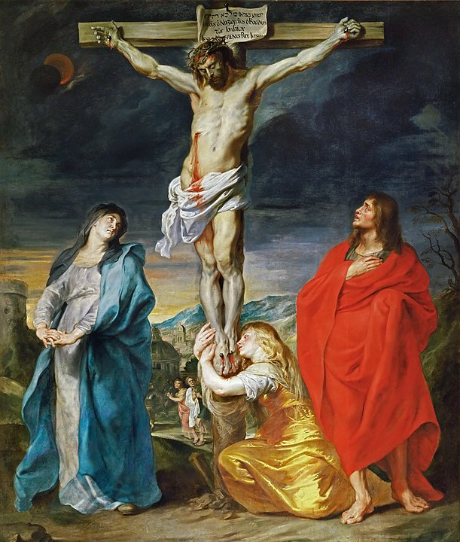
12th Station: Jesus Speaks to His Mother and the Disciple
Leader: We adore you, O Christ, and we bless you.
R/. Because by your holy Cross you have redeemed the world.
Reader: Standing by the cross of Jesus were his mother and his mother's sister, Mary the wife of Clopas, and Mary of Magdala. When Jesus saw his mother and the disciple there whom he loved, he said to his mother, “Woman, behold, your son.” Then he said to the disciple, “Behold, your mother.” And from that hour the disciple took her into his home. -Jn 19: 25-27 Leader: Lord, grant us constancy that we may be willing to stand by those in need.
R/. Lord Jesus, help us walk in your steps.

Slide 15
13th Station: Jesus Dies on the Cross
Leader: We adore you, O Christ, and we bless you.
R/. Because by your holy Cross you have redeemed the world.
Reader: It was now about noon and darkness came over the whole land until three in the afternoon because of an eclipse of the sun. Then the veil of the temple was torn down the middle. Jesus cried out in a loud voice, “Father, into your hands I commend my spirit”; and when he had said this he breathed his last. -Lk 23: 44-46 Leader: Lord, grant us trust in you that when our time on earth in ended our spirits may come to you without delay.
R/. Lord Jesus, help us walk in your steps.

Slide 16
14th Station: Jesus is Placed in the Tomb
Leader: We adore you, O Christ, and we bless you.
R/. Because by your holy Cross you have redeemed the world.
Reader: When it was evening, there came a rich man from Arimathea named Joseph, who was himself a disciple of Jesus. He went to Pilate and asked for the body of Jesus; then Pilate ordered it to be handed over. Taking the body, Joseph wrapped it [in] clean linen and laid it in his new tomb that he had hewn in the rock. Then he rolled a huge stone across the entrance to the tomb and departed. -Mt 27: 57-60 Leader: Lord, grant us your compassion that we may always provide for those in need.
R/. Lord Jesus, help us walk in your steps.

Slide 17
Closing Prayer
Leader: Lord Jesus Christ, your passion and death is the sacrifice that unites earth and heaven and reconciles all people to you. May we who have faithfully reflected on these mysteries follow in your steps and so come to share your glory in heaven where you live and reign with the Father and the Holy Spirit, God, for ever and ever.
R/. Amen.

Slide 18
Image Credits
The Agony in the Garden by Giuseppe Cesari
The Taking of Christ by Caravaggio
Jesus about to be struck in front of former High Priest Annas by José de Madrazo
The Denial of St. Peter by Caravaggio
Christ and Pilate (What is Truth?) by Nikolai Ge
The Flagellation of Christ by Caravaggio
Jesus Embraces the Cross by El Greco
Christ Carrying the Cross by Titian

Slide 19
Christ Falling on the Way to Calvary by Raphael
The Crucified Christ by Peter Paul Reubens
Christ and the Good Thief by Titian
Crucifixion by Anthony van Dyck
Christ Crucified by Diego Velázquez
The Entombment of Christ by Caravaggio

